Slide 1
E-SAMPLING
CAPTURE TOTALE
JAN 2021

Slide 2
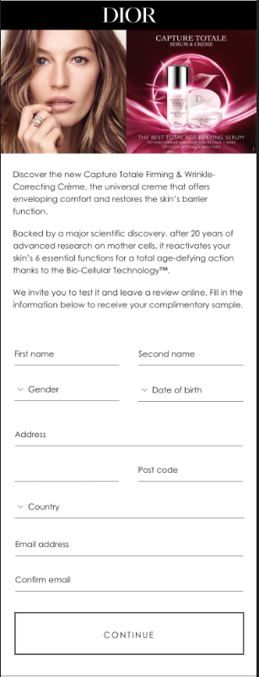
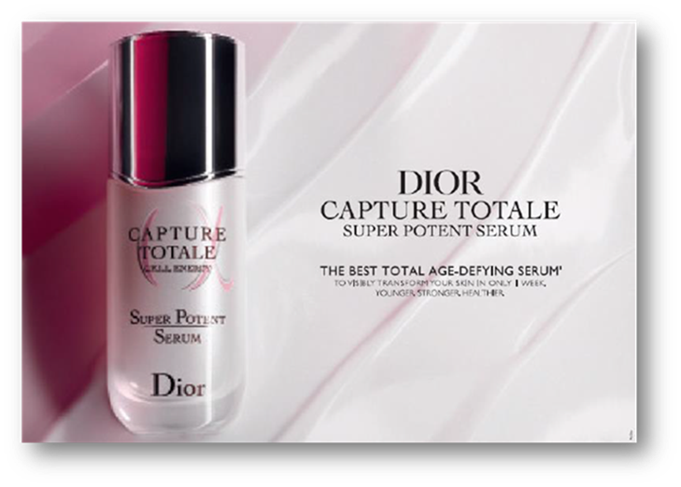
INTERFACE
Replace Capture Totale visual with new visual
Please, remove the Dior logo.
Please replace text with the below (keep the text below the red line):
Discover the new Capture Totale line, which combines 20 years of pioneering research on mother cells with the power of Dior floral science to offer a visible skin transformation and total age-defying correction.
The hero product of the Capture Totale line, Super Potent Serum re-energizes the precious skin’s mother cells and reactives 6 essential functions of the skin for total age-defying action.
Please insert ‘City’ here

Slide 3
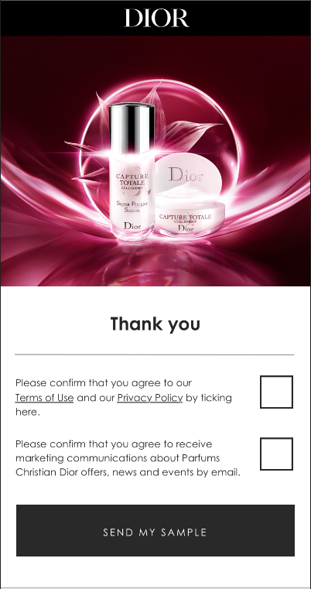

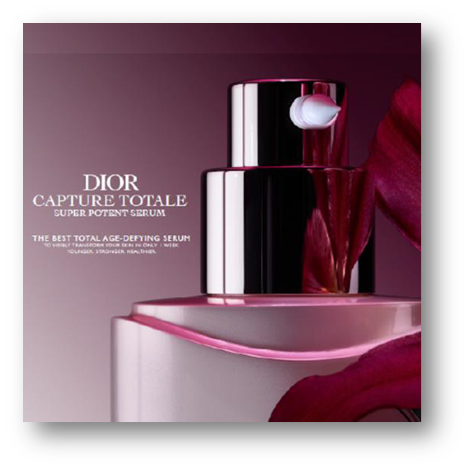
INTERFACE
Replace Capture Totale visuall with new visual
Use the same T&C’s text

Slide 4
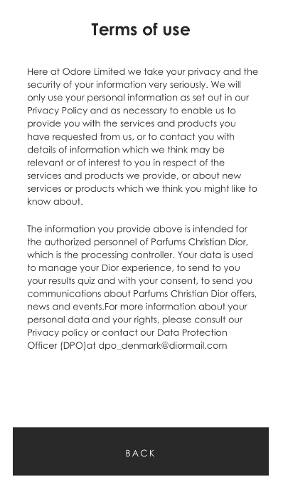
TERMS & CONDITIONS
Use the same Terms of use

Slide 5
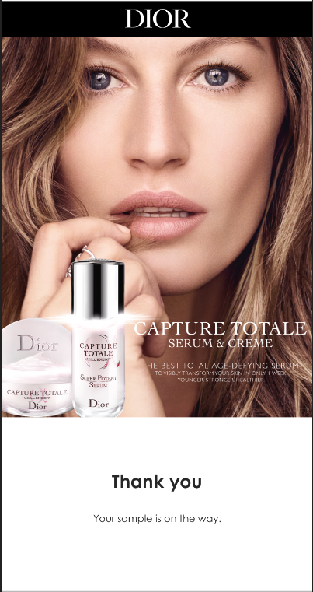
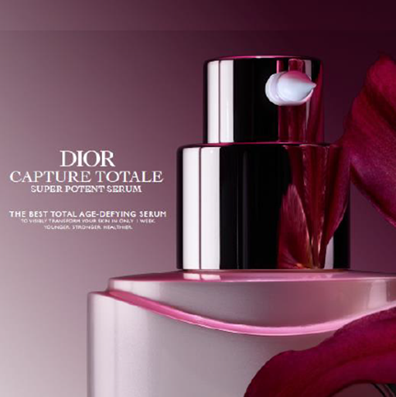
THANK YOU PAGE
Update Capture Totale visual with new visual
Keep the same text

Slide 6

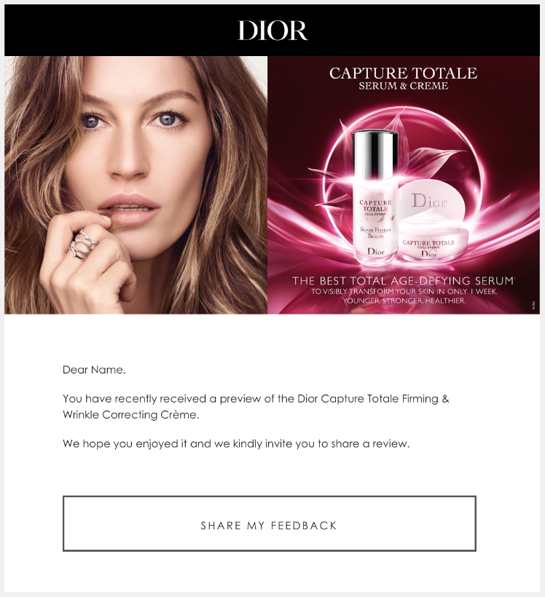
RECALL EMAIL
Replace Capture Totale visual with new visual
Replace text with the text under:
Dear Name,
You have recently received a sample of the Dior Capture Totale Super Potent Serum.
We hope you enjoyed it and we kindly invite you to share a review.

Slide 7
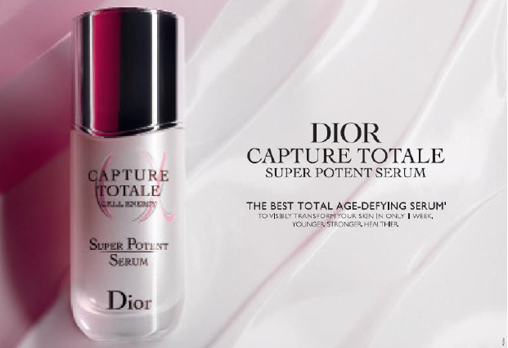
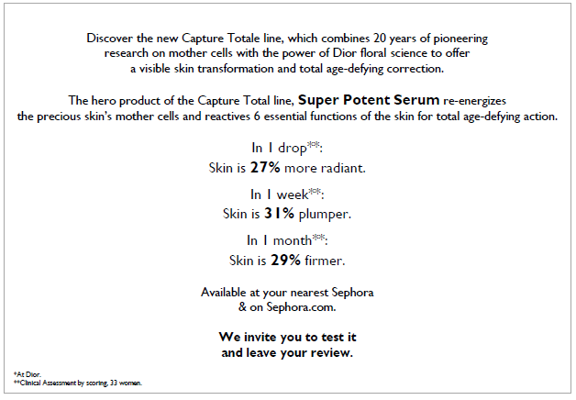
SAMPLING CARD
Use same visual and text as over
Remove text about Sephora
Insert this sentients: “We invite you to test it and leave your review at your preferred Webshop.”

